Slide 1
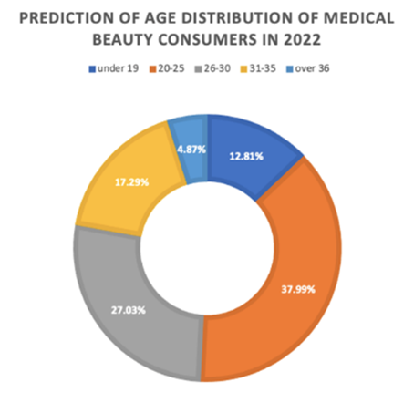
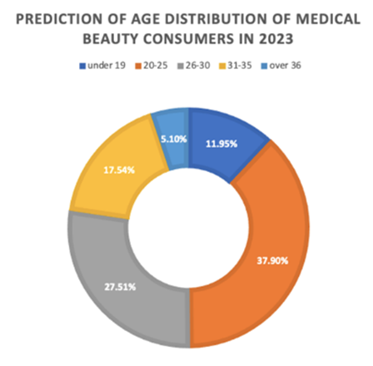
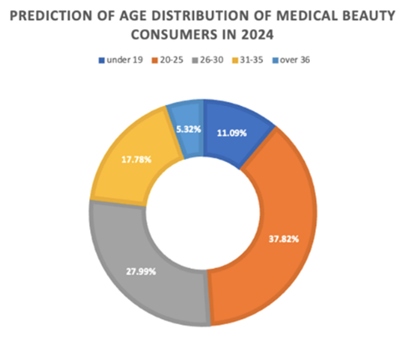
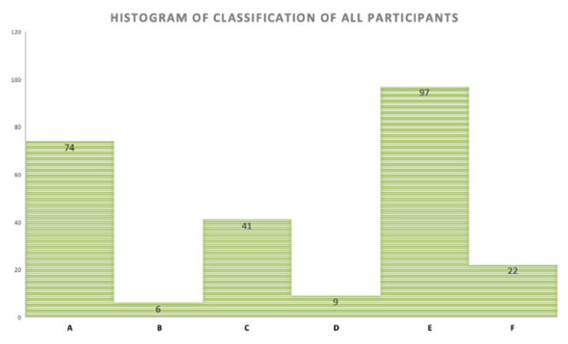
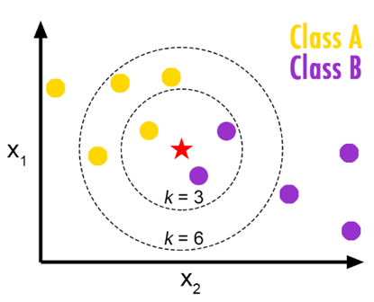
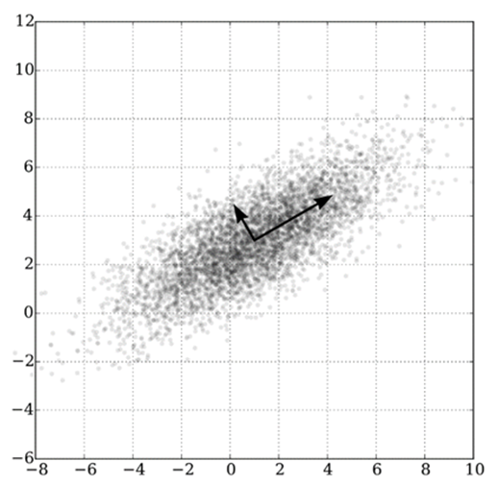
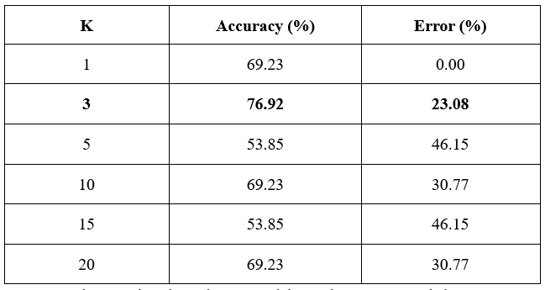
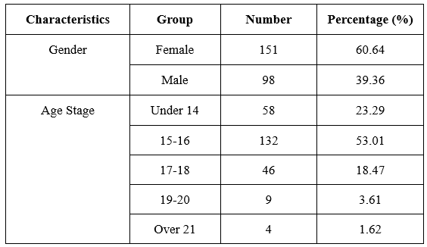
Adolescent Dysmorphic Disorder Model Research based on Machine Learning
Background Research
Our solution
Graphs
Anxiety hides many personality problems behind it and motivates individuals to do things that are designed to maintain self-esteem and relieve tension.
Dysmorphic disorder refers to an individual's subjective, comprehensive and evaluative anxiety about physical characteristics, and consists of different components such as appearance concern, appearance evaluation, and body shape anxiety.
It is imperative to carry out research on the problem of facial anxiety among adolescents and put forward some suggestions and solutions.
We collected the most comprehensive dataset of the self-assessment of the adolescent image by filling in a questionnaire, which covers a wide range of facial indicators that adolescents pay more attention to.
For the above dataset, different dysmorphic disorder assessment algorithms based on multiple machine learning strategies have been constructed on this dataset.
ML models have been developed to evaluate the degree of adolescent dysmorphic disorder, including KNN and NB models with the utilization of PCA.
The trend of dysmorphic disorder among contemporary Chinese adolescents has been predicted by using the ordinary least squares linear regression.
Related works
Machine Learning (ML) is a subfield of artificial intelligence (AI) that can allow us to help the computer learn from past data or experiences to make predictions with high accuracy and high speed, and it works well for big datasets.
The K-Nearest Neighbor (KNN) algorithm is a kind of effective machine learning algorithm, which is very helpful and effective for both classification and regression problems even though the application for classification prediction is more extensive [1].
The Naïve Bayes (NB) algorithm [2] is also one of the most used practical methods for solving classification problems. NB can work well even though with a small amount of data and can handle multiple classes.
Principal Component Analysis (PCA) is a standard and effective tool for handling modern data analysis [3], in fields ranging from mathematics, physics, chemistry, biology, and neuroscience to computer graphics.
Results
Data description
The survey was conducted among teenagers aged 13 to 20, most of whom were middle school, high school, or college students.
To improve the accuracy and universality of the questionnaire results, we spread the questionnaires to 19 provinces in China. Finally, 249 samples were obtained after preliminary screening out the cases of random filling in their questionnaires.
Conclusion
Works Cited
The best self-evaluation model developed in this project gave the highest accuracy of 76.92% on the testing set. The results showed that all of the original 29 features work well and work together, and they are all prominent for this project.
This project may provide reference value to some extent and novel thoughts for the research with a large sample size. In addition, this project will be able to contribute to promoting or driving more relevant research to ensure the healthy growth of young people, especially their mental health.
[1] Taunk, K., De, S., Verma, S., & Swetapadma, A. (2019). A brief review of nearest neighbor algorithm for learning and classification. 2019 International Conference on Intelligent Computing and Control Systems (ICCS) (pp. 1255-1260).
[2] Karthika, S., & Sairam, N. (2015). A Naïve Bayesian classifier for educational qualification. Indian Journal of Science and Technology, 8(16), 1-5.
[3] Shlens, J. (2014). A tutorial on principal component analysis. arXiv.
Characteristics of data

